Slide 1
DOMUSIC
Guide: Prof. Manoj T Joy
Done By,
Abhijith M.D
Ajo John Mathai
Anju Mathew
Ashna Ann Babu

Slide 2
Introduction
Unique platform to play, enjoy and share the world of music.

Slide 3
Current Systems
Sound Cloud is one of the top musical platform which allows musicians to share music
Soundation is a platform to edit the music by registering as a paid user
Mp3skull, a platform to download songs
Metrolyrics, a platform to get lyrics
Spotify, a platform to relese new songs

Slide 4
Proposed Systems
Domusic is a platform to express music to all who love music
Provides a seamless way to get the right music
Gets the latest news in music
Helps to record and edit on air
Helps to make new music and go live for the world to listen

Slide 5
Features
Live recording
Pitch detecting technology
Tempo Detecter
Independent playlist
Mixing platform
Musical search

Slide 6
Hardware Requirements
Processor : Intel Pentium 3 or above
Monitor : 14 colour monitor SVGA
Keyboard : 104 flash key windows keyboard
RAM : 250 Mb or above
OS : Windows XP or Above

Slide 7
Software Requirements
Server Side: - Website should be hosted by using WAMP or any other web host servers .
Client Side :- An Operating System supporting standard web browser is required. MS Windows XP or above is suitable.

Slide 8
Network Requirements
Basic network protocols like http, FTP, TCP/IP are used.

Slide 9
DATA FLOW DIAGRAM

Slide 10
Data Flow Diagram
LEVEL-0:
USER
SEARCH MUSIC
USER
Request
Response

Slide 11
Data Flow Diagram
SEARCH MUSIC
1.0
GUEST
USER
Request
LEVEL : 1
-GUEST USER
Search Key
Search Key
PLAY MUSIC
1.1
DOWNLOAD MUSIC
1.2
Music File
Download File
Music File
Music Name
Music Name
Download File
GUEST USER
GUEST USER
SONG DB

Slide 12
Data Flow Diagram
VERIFY USERS
1.0
ADMIN
Verified Details
ADMIN
Request
Username
User
Details
LEVEL : 1
-ADMIN
Request
Request
Song Files-New,
Excluding Removed file
PROFILE DB
UPDATE NEWS
2.0
ADD/DELETE SONG
3.0
News File including News Update
News
Category
News Files
Song
Name
Song
File
NEWS DB
SONG DB

Slide 13
LEVEL : 1 -REGISTERED USER
User name
REGISTERED USERS
SIGN UP
1.0
Password
Request
PROFILE DB
Username
Request
Password
Request
LOGIN
2.0
Request
Request
Request
Request
Request
MIX
4.0
RECORD
5.0
PITCH
6.0
TEMPO
7.0
PLAYLIST
8.0
Username
User
details
Password
EDIT
PROFILE
3.0
PROFILE DB
Playlist
Details
Record
File
Playlist
Details
Voice File
Voice File
Mixed File
Mixed File
Record File
SONG DB
STUDIO DB
PLAYLIST DB
New User
details
New Pitch File
User details
Tempo Number & Click
Updated User Details
REGISTERED USERS
PROFILE DB
Playlist Details

Slide 14
LEVEL : 2 -REGISTERED USER
REGISTERED USERS
Data Flow Diagram
Request
PUBLISH
2.1.0
Request
UPLOAD
2.1.1
Uploaded music file
New
Music File
SONG DB
REGISTERED USERS

Slide 15
DOMUSIC- DATA BASE
Song Table
Playlist Table
Profile Table
News Table
Studio Table

Slide 16
SONG:
Name | Null? | Type
S_id | NOT NULL | Varchar(20)
S_Name | NOT NULL | varchar(20)
S_Cat | NOT NULL | varchar(10)
S_File | NOT NULL | varchar(50)
S_Details |  | varchar(80)
Primary Key

Slide 17
PLAYLIST:
Name | Null? | Type
Pl_Name | NOT NULL | Varchar(20)
Pl_Uname | NOT NULL | varchar(30)
Pl_Sid | NOT NULL | Number
Pl_File | NOT NULL | varchar(50)
Primary Key
Foreign Key

Slide 18
PROFILE:
Name | Null? | Type
P_UName | NOT NULL | varchar(20)
P_Password | NOT NULL | varchar(30)
P_Name | NOT NULL | varchar(20)
P_Address |  | text
P_Email | NOT NULL | varchar(20)
P_Phn |  | Number
P_Dp |  | varchar(50)
P_Country |  | varchar(30)
P_Ncat | NOT NULL | varchar (30)
Primary Key
Foreign Key

Slide 19
NEWS:
Name | Null? | Type
N_Ncat | NOT NULL | Varchar(50)
N_src | NOT NULL | varchar(50)
Primary Key

Slide 20
STUDIO:
Name | Null? | Type
S_UName | NOT NULL | Number
S_Name |  | Varchar (30)
S_Sid | NOT NULL | Varchar (20)
S_File |  | Varchar (50)
Primary Key
Foreign Key

Slide 21
Conclusion
As mentioned above domusic provides a unique integrated music experience for all who love music.
It helps the world to be connected in music.
Promotes budding musicians with great tools to develop their extravagent songs, absolutely free..!!!

Slide 22
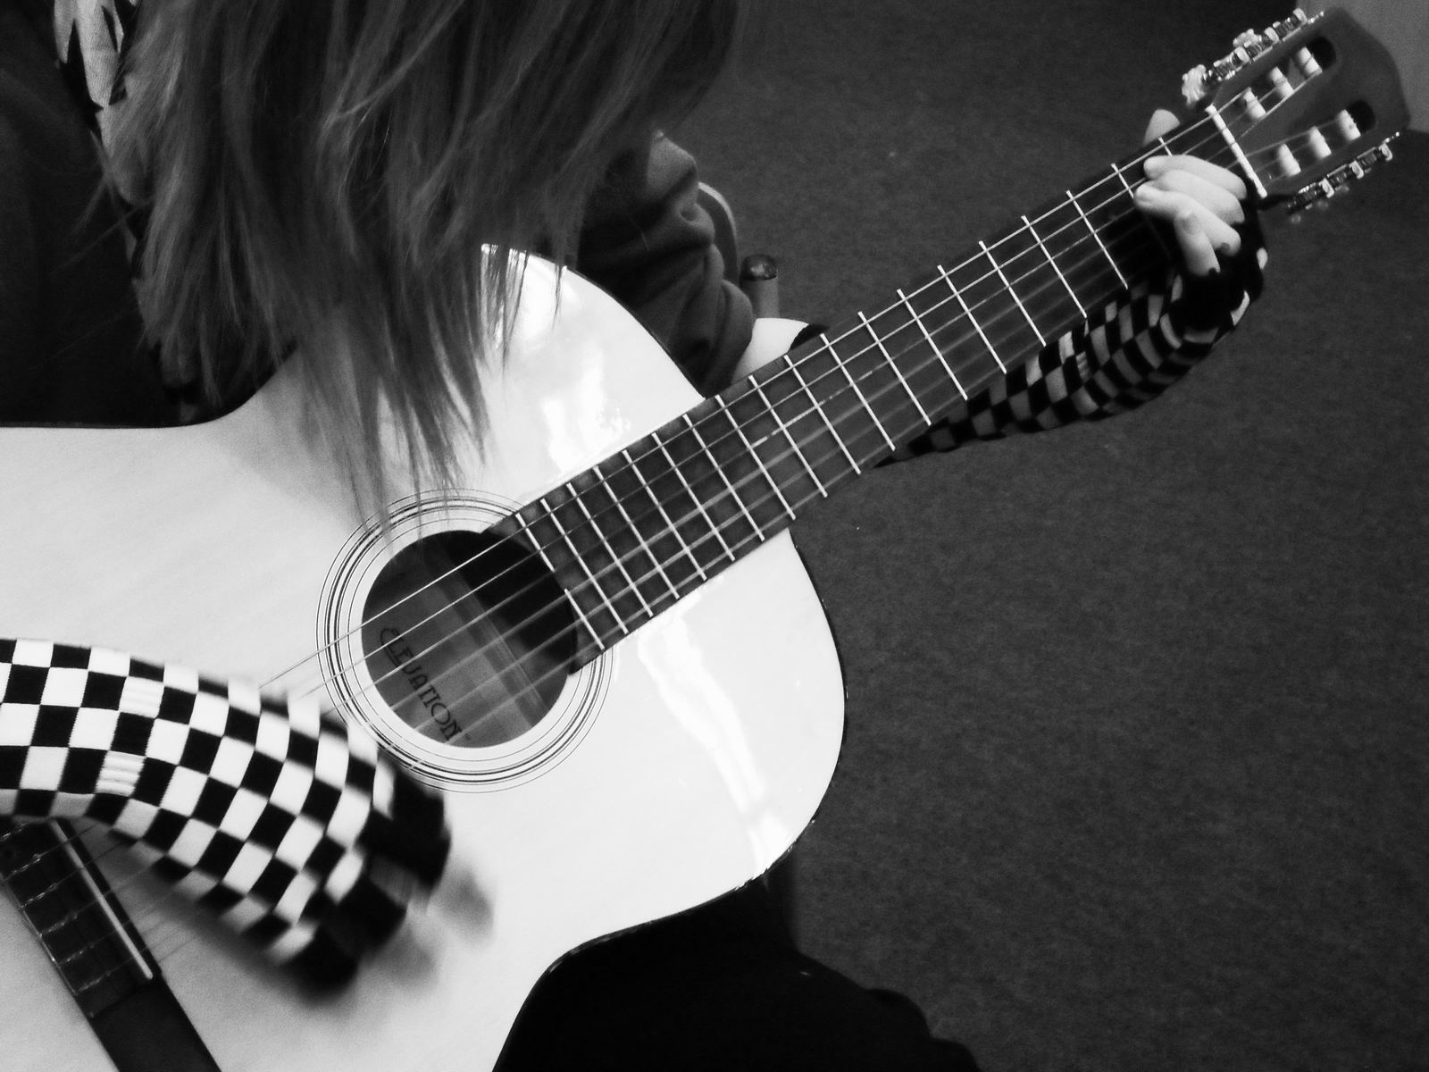
LOVE MUSIC
domusic

Slide 23
“The Noble Art Of Music Is The Greatest Treasure In the World”
- Martin Luther

Slide 24
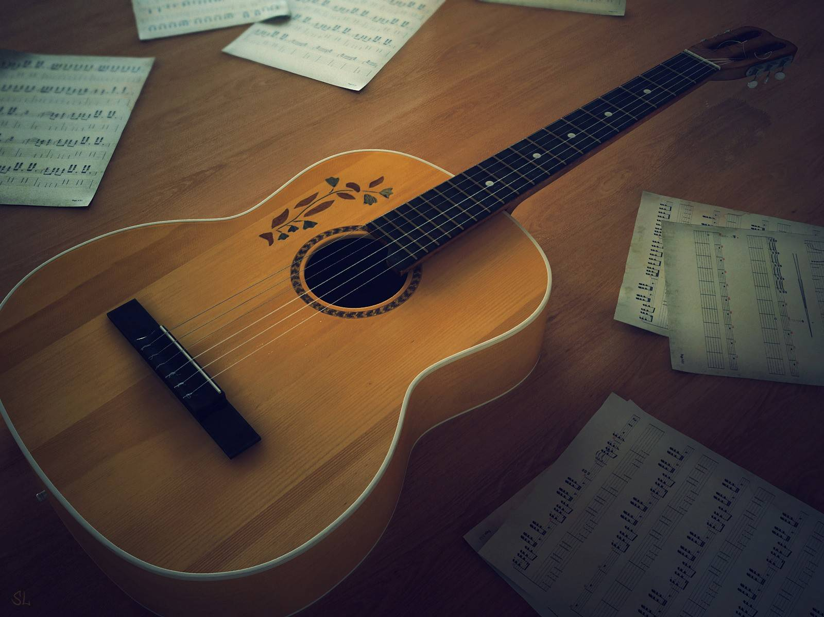
Thanks!
domusic@gmail.com
www.domusic.com

